Slide 1
Assembly Language Program

Slide 2
Machine language instruction
Each personal computer has a microprocessor that manages the computer's arithmetical, logical and control activities.
Each family of processors has its own set of instructions for handling various operations like getting input from keyboard, displaying information on screen and performing various other jobs.
These set of instructions are called 'machine language instruction'.

Slide 3
Advantages:
An understanding of assembly language provides knowledge of:
Interface of programs with OS, processor and BIOS;
Representation of data in memory and other external devices;
How processor accesses and executes instruction;
How instructions accesses and process data;
How a program access external devices.
It requires less memory and execution time;

Slide 4
Machine Cycle
For every instruction, a processor repeats a set of four basic operations, which comprise a machine cycle
Fetching: Process of obtaining a program instruction or data item from memory.
Decoding: Process of translating the instruction into signals the computer can execute.
Executing: Process of carrying out the commands.
Storing: Writing results to memory.

Slide 5
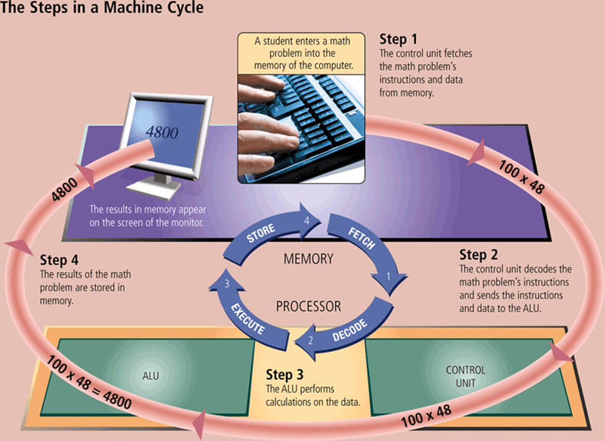
Machine Cycle

Slide 6
Basic Syntax
An assembly program can be divided into three sections:
The data section
The bss section
The text section
The data Section:
The data section is used for declaring initialized data or constants.
This data does not change at runtime.
The syntax for declaring data section is: section .data

Slide 7
Basic Syntax
The bss Section:
The bss section is used for declaring variables.
The syntax for declaring bss section is: section .bss
The text Section:
The text section is used for keeping the actual code.
This section must begin with the declaration global _start, which
tells the kernel where the program execution begins.
The syntax for declaring text section is:
section .text
global _start
_start:

Slide 8
Statement
Assembly language statements are entered one statement per line. Each statement follows the following format:
[label] mnemonic [operands] [;comment]
The fields in the square brackets are optional. A basic instruction has two parts,
the first one is the name of the instruction (or the mnemonic) which is to be executed, and
the second are the operands or the parameters of the command

Slide 9
Program
assembly language code displays the string 'Hello World' on the screen:
section .text
global _start ;must be declared for linker (ld)
_start : ;tells linker entry point
mov edx,len ;message length
mov ecx,msg ;message to write
mov ebx,1 ;file descriptor (stdout)
mov eax,4 ;system call number (sys_write)
int 0x80 ;call kernel

Slide 10
Program (Cont.)
mov eax,1 ;system call number (sys_exit)
int 0x80 ;call kernel
section .data
msg db 'Hello, world!', 0xa ;our display string
len equ $ - msg ;length of the display string

Slide 11
Assembly Registers
There are ten 32-bit and six 16-bit processor registers in IA-32 architecture. The registers are grouped into three categories:
General registers
Control registers
Segment registers
The general registers are further divided into the following groups:
Data registers
Pointer registers
Index registers

Slide 12
Assembly Registers (Cont.)
Data Registers :
Four 32-bit data registers are used for arithmetic, logical and other operations.
These 32-bit registers can be used in three ways:
1. As complete 32-bit data registers: EAX, EBX, ECX, EDX.
2. Lower halves of the 32-bit registers can be used as four 16-bit data registers: AX, BX, CX and DX.
3. Lower and higher halves of the above-mentioned four 16-bit registers can be used as eight 8-bit data registers: AH, AL, BH, BL, CH, CL, DH, and DL.

Slide 13
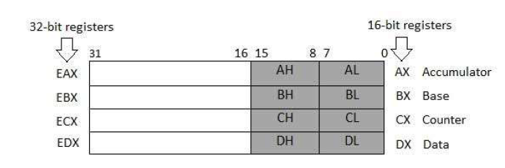

Slide 14
Program-2
;program displays 9 stars on the screen
section .text
global _start ;must be declared for linker (gcc)
_start: ;tell linker entry point
mov edx,9 ;message length
mov ecx,s2 ;message to write
mov ebx,1 ;file descriptor (stdout)
mov eax,4 ;system call number (sys_write)
int 0x80 ;call kernel
mov eax,1 ;system call number (sys_exit)
int 0x80 ;call kernel
section .data
;length of message
s2 times 9 db '*'

